Slide 1
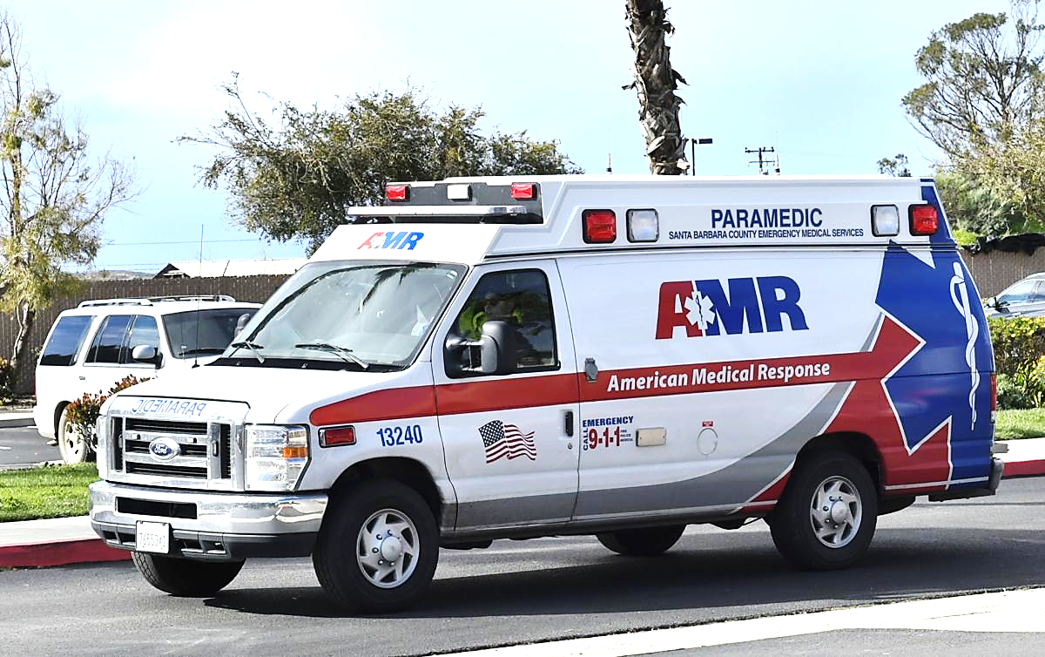
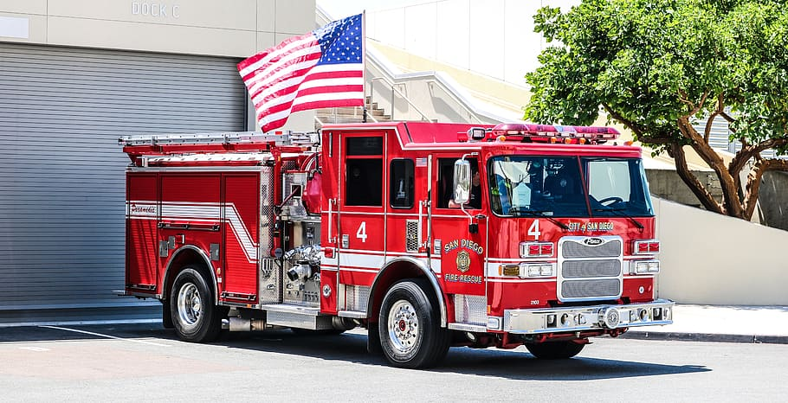
SAVE THE DATE!
October 3, 2023
8:00 Am – 12:30 pm
State of California
Virtual Trauma Summit
Contact Julie McGinnis at Julie.mcginnis@emsa.ca.gov for more information

